Slide 1

Beylikten OSMANLI PADİŞAHLARINA
www.HangiSoru.com
2 BEY
36 OSMANLI PADİŞAHI

Slide 2
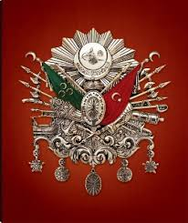
OSMANLI PADİŞAHLARI

Slide 3
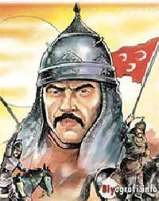
Süleyman ŞAH

Slide 4
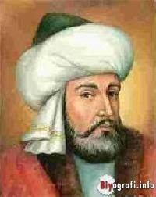
Ertuğrul Bey

Slide 5
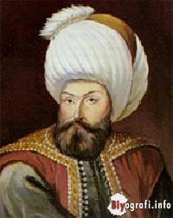
Osman Bey

Slide 6
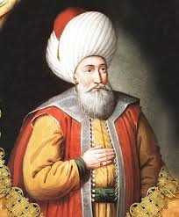
Orhan Gazi

Slide 7
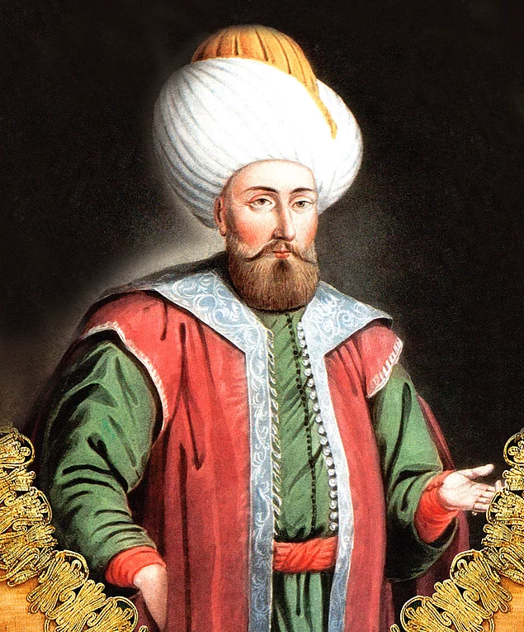
I.Murad

Slide 8
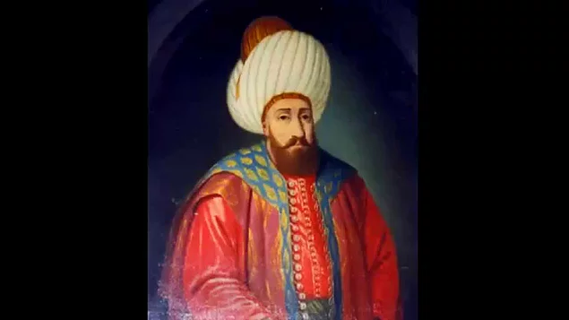
Yıldırım Bayezid

Slide 9
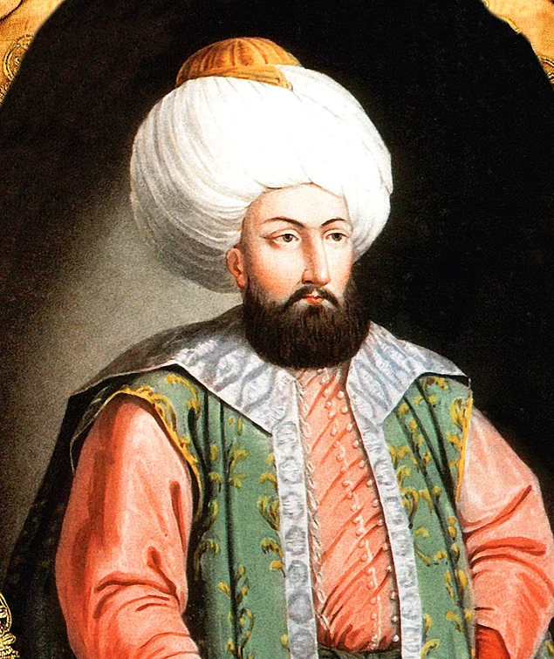
I.Mehmed

Slide 10
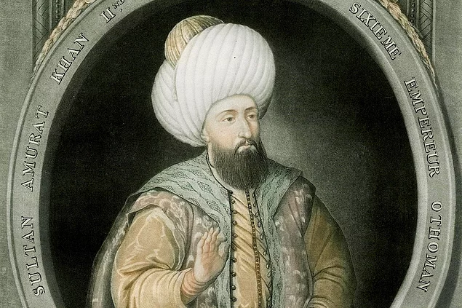
II.Murad

Slide 11
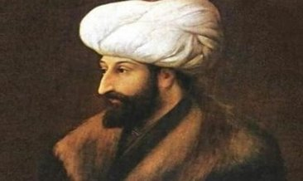
Fatih Sultan Mehmed (II.Mehmed)

Slide 12
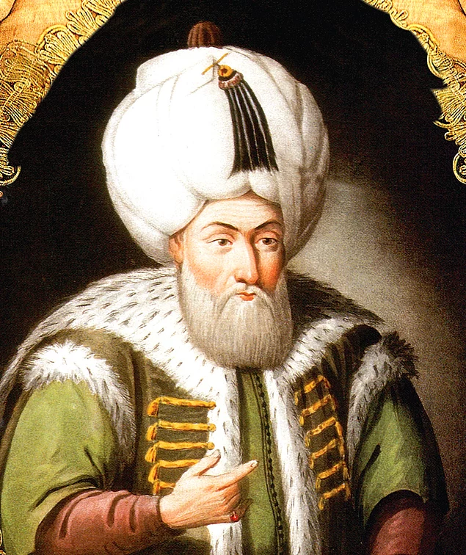
II.Bayezid

Slide 13
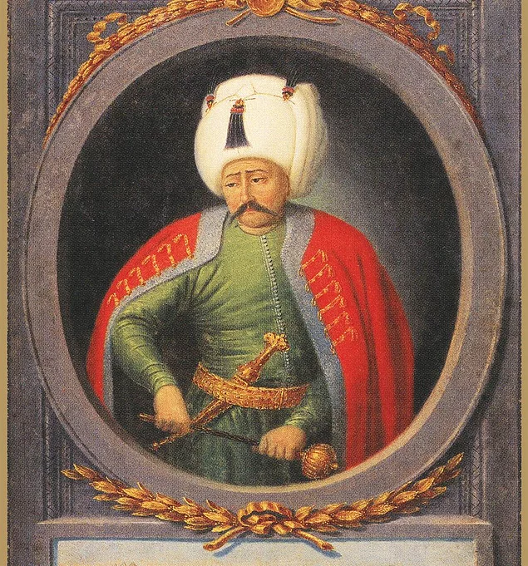
Yavuz Sultan Selim

Slide 14
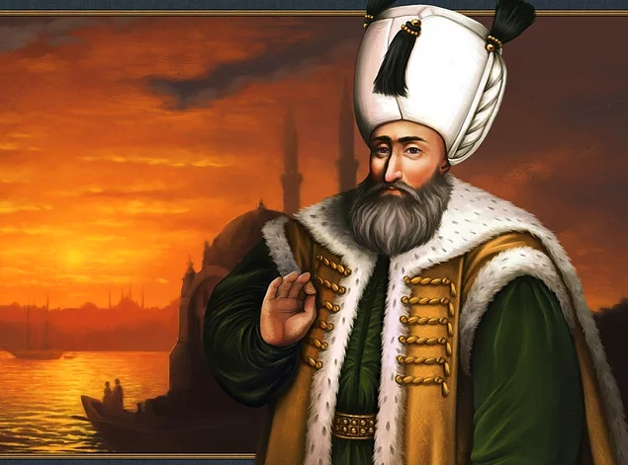
Kanuni Sulatan Süleyman

Slide 15
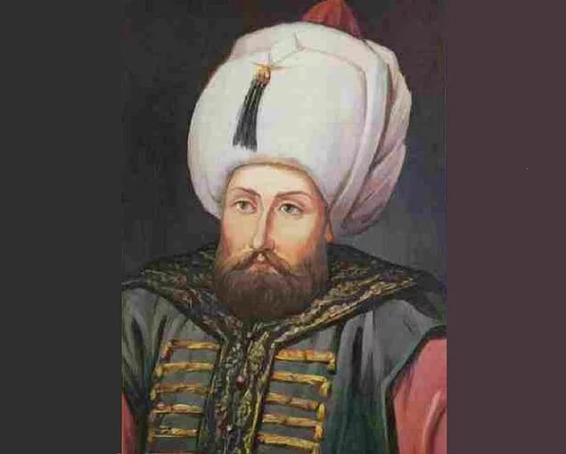
II.Selim

Slide 16
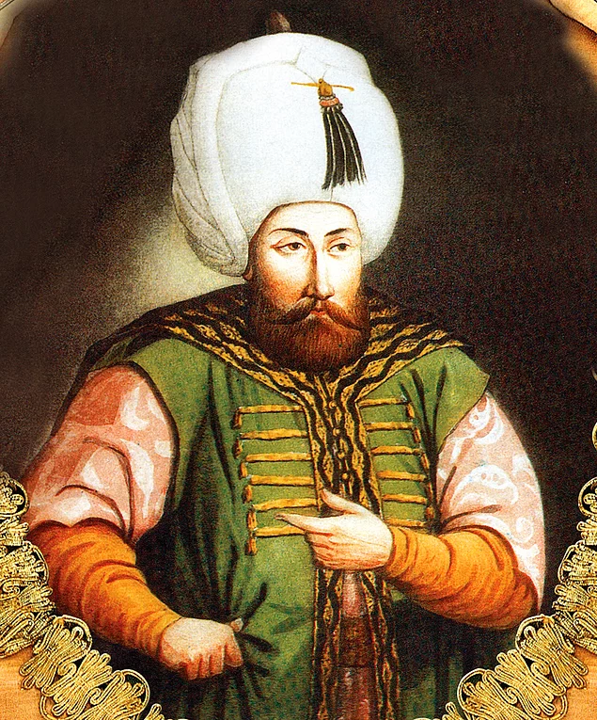
III.Murad

Slide 17
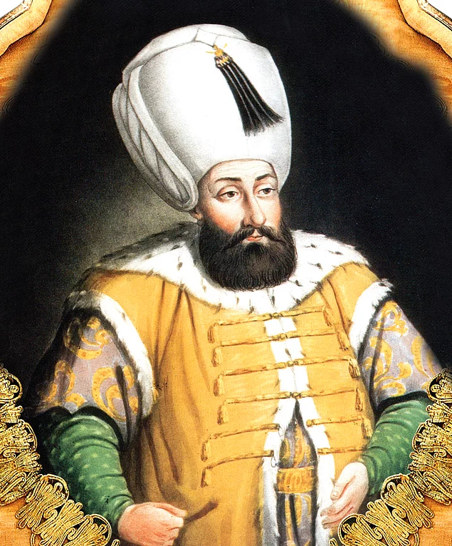
III.Mehmed

Slide 18
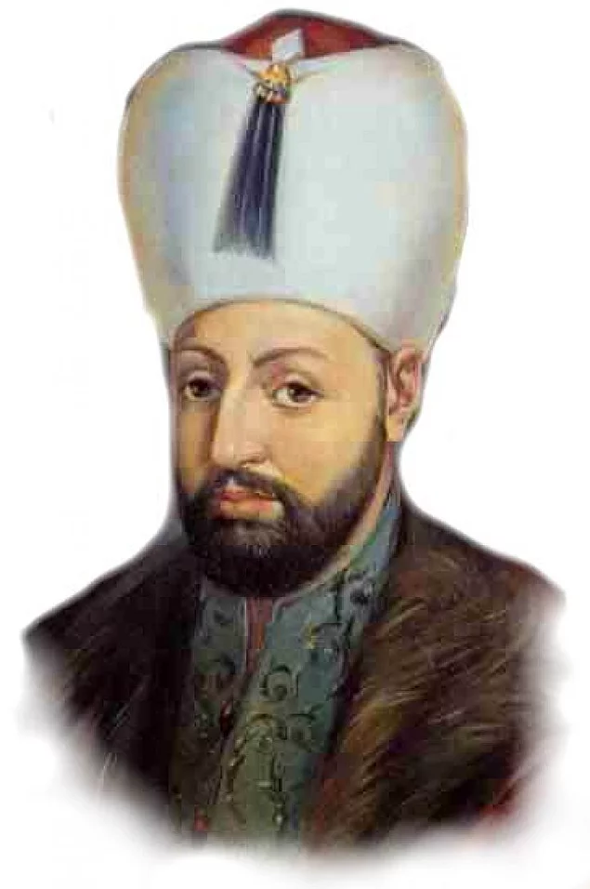
I.Ahmed

Slide 19
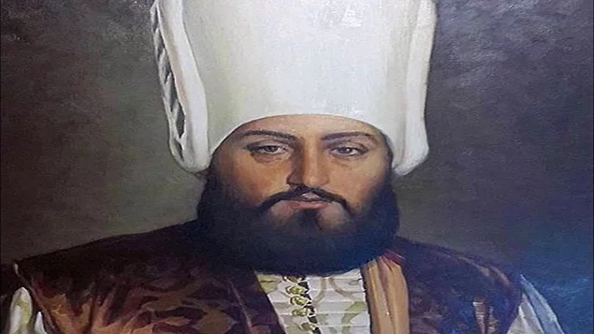
I.Mustafa

Slide 20
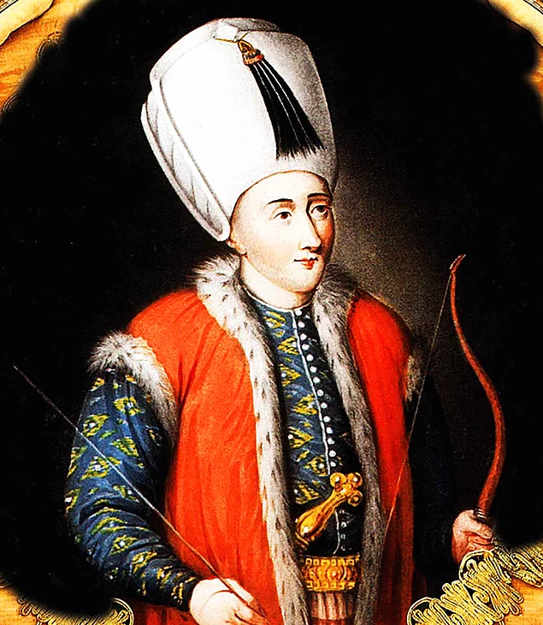
Genç Osman

Slide 21
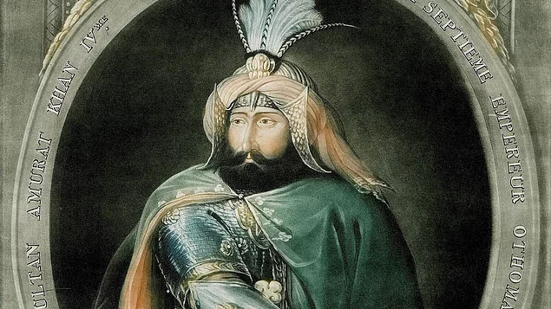
IV.Murad

Slide 22
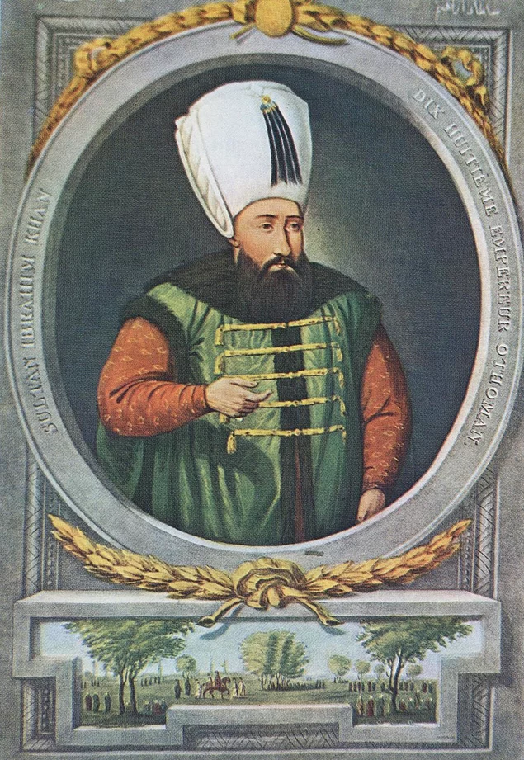
İbrahim

Slide 23
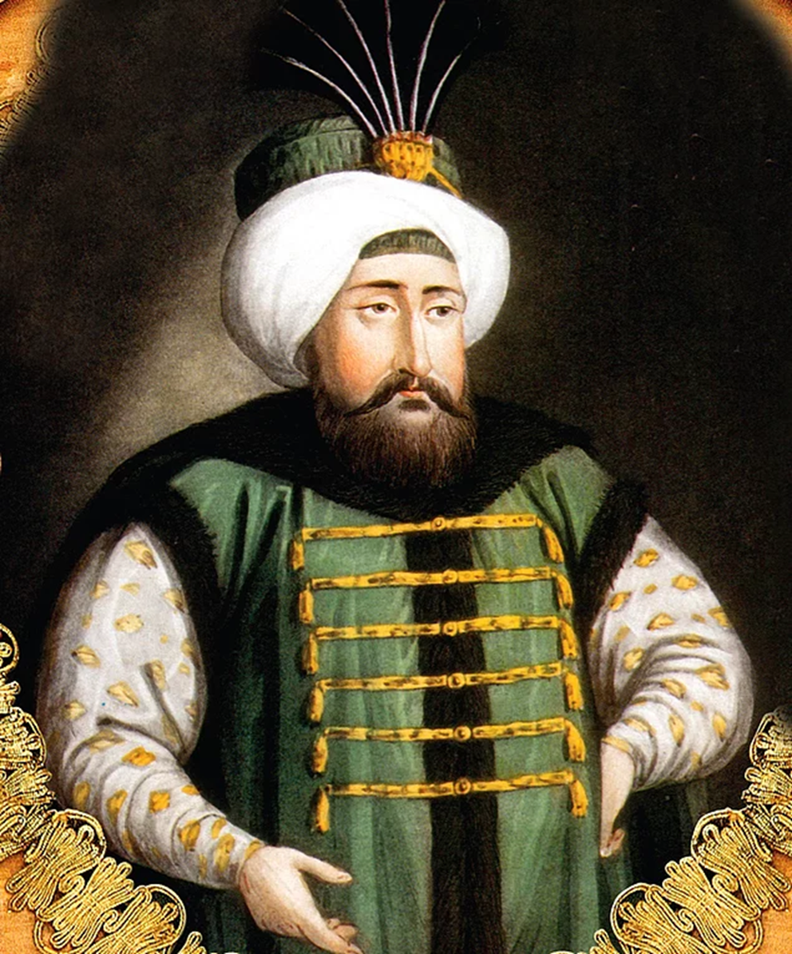
IV.Mehmed

Slide 24
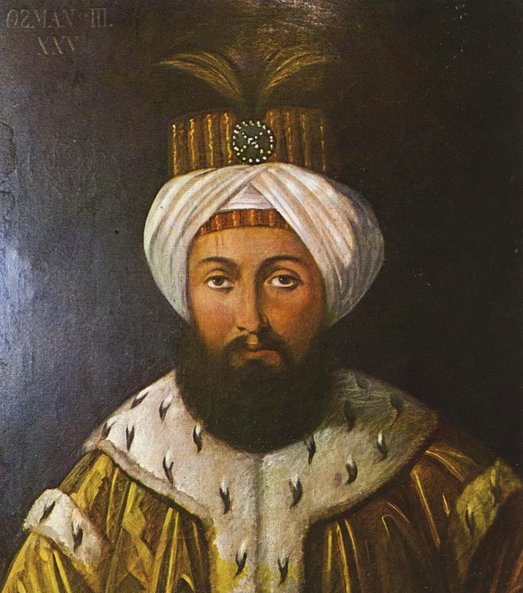
II.Süleyman

Slide 25
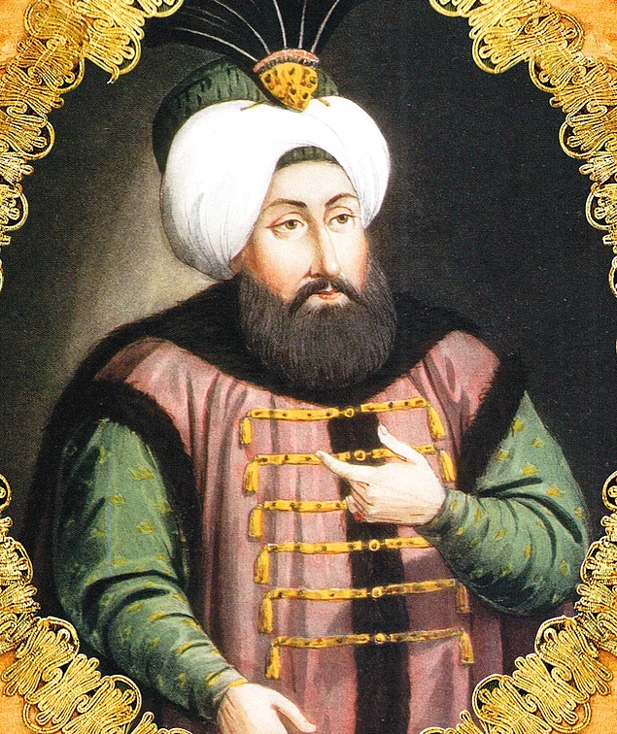
II.Ahmed

Slide 26
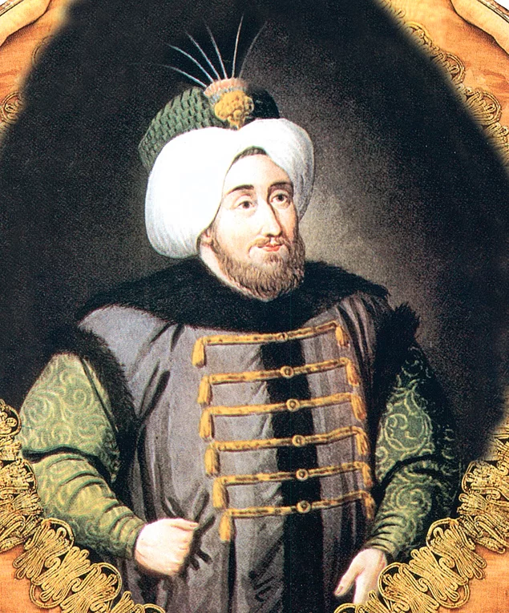
II.Mustafa

Slide 27
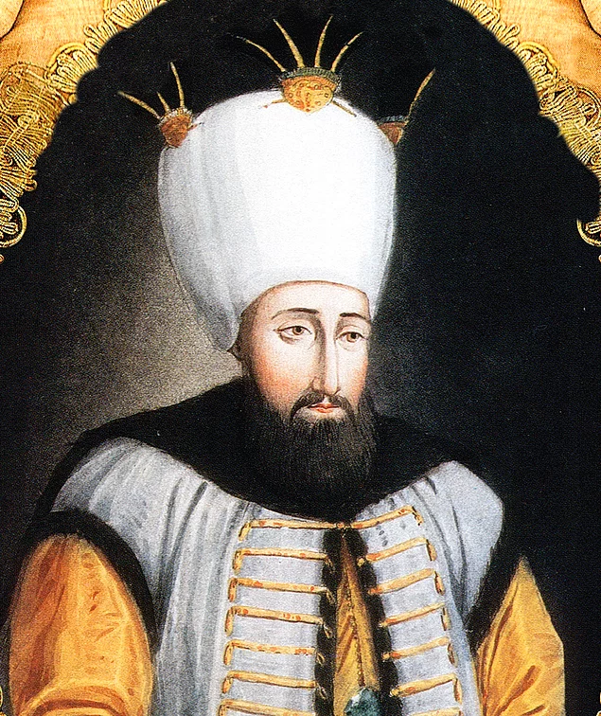
III.Ahmed

Slide 28
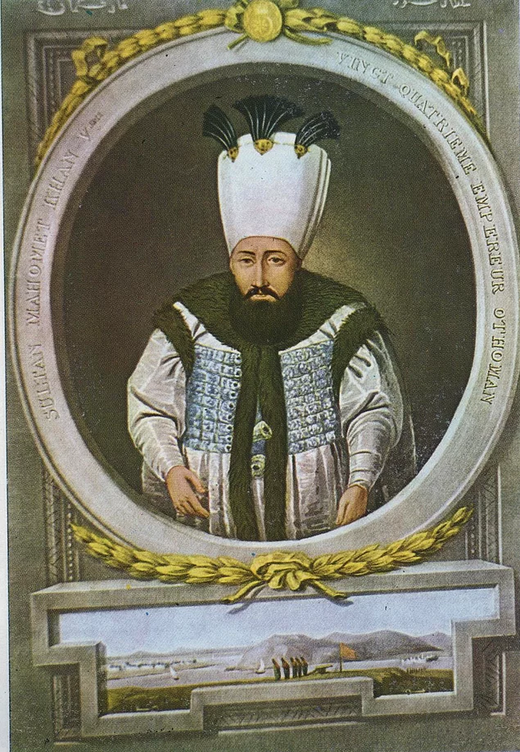
I.Mahmud

Slide 29

III.Osman

Slide 30
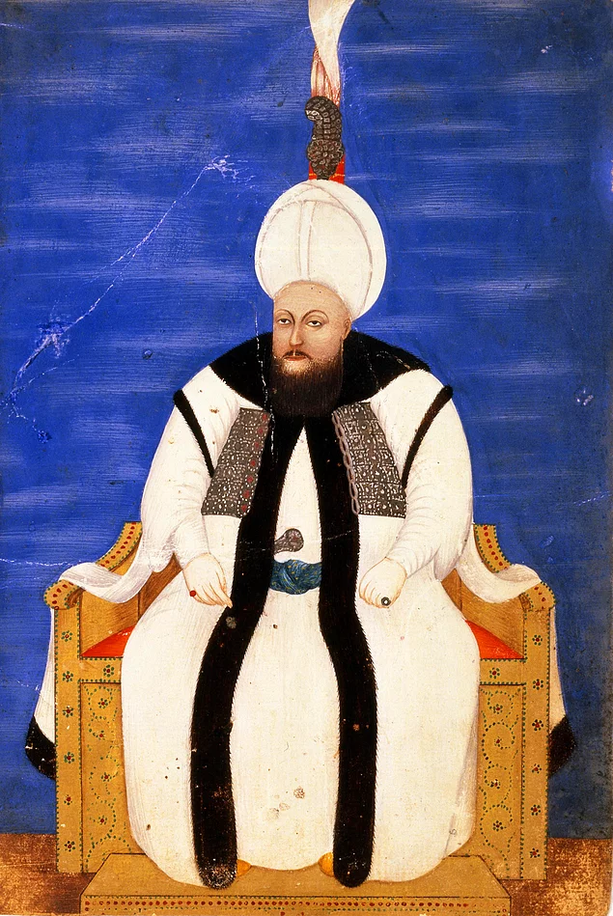
III.Mustafa

Slide 31
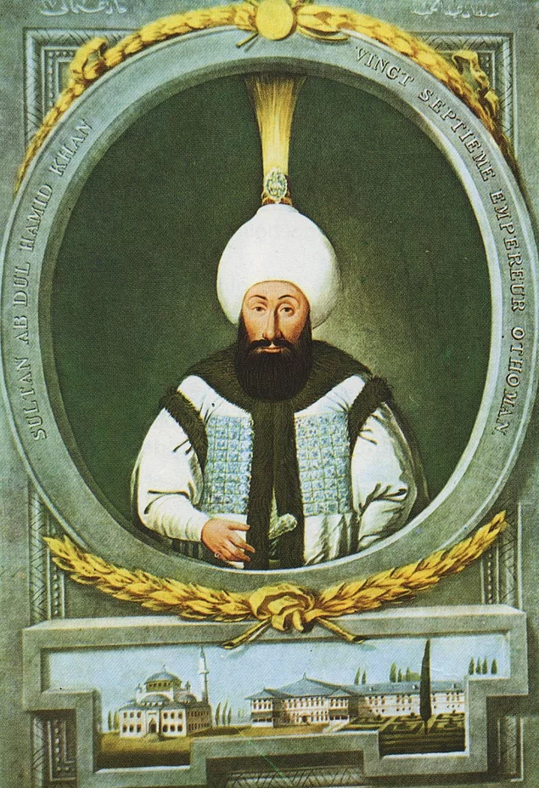
I.Abdülhamid

Slide 32
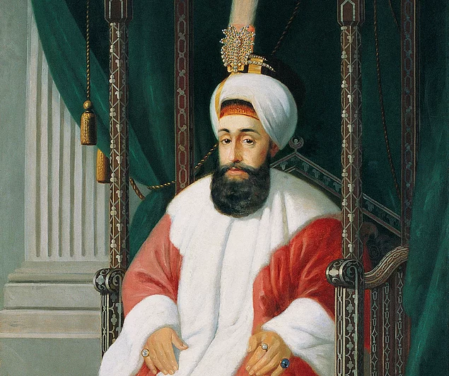
III.Selim

Slide 33
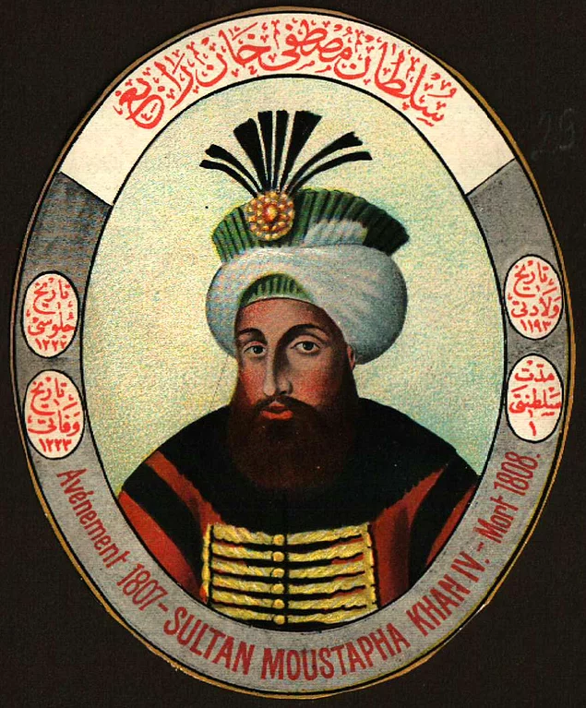
IV.Mustafa

Slide 34
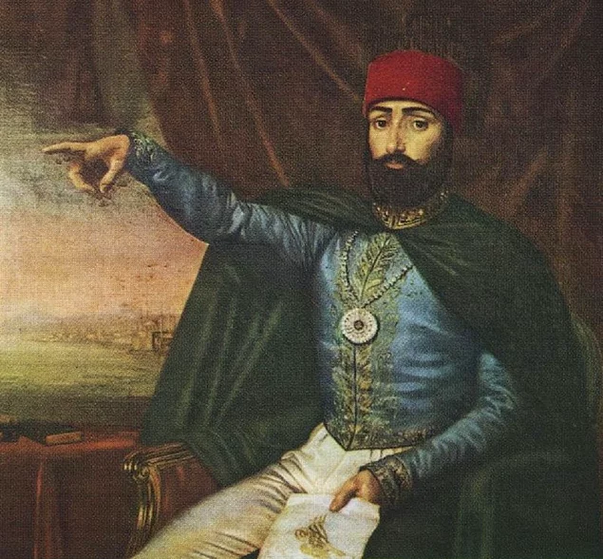
II.Mahmud

Slide 35
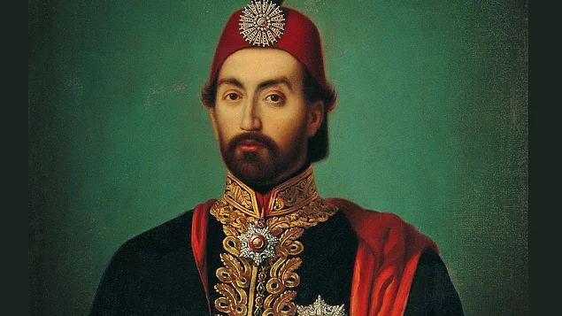
Abdülmecid

Slide 36
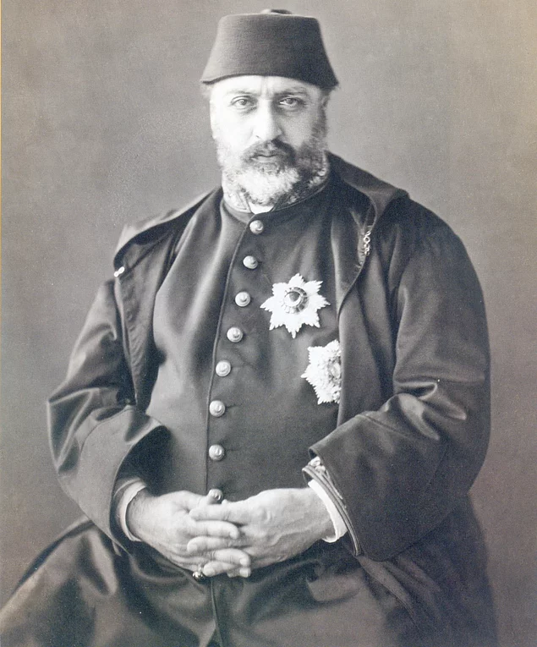
Abdülaziz

Slide 37
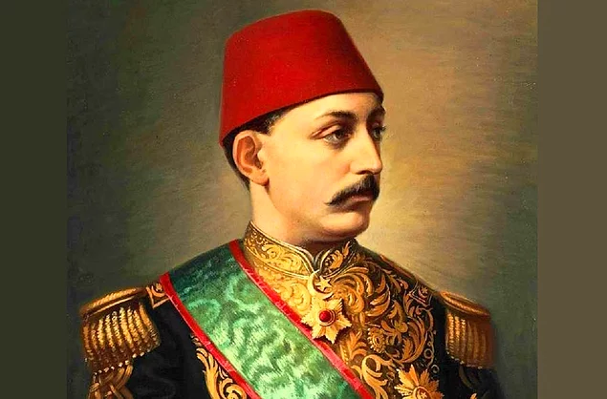
V.Murad

Slide 38
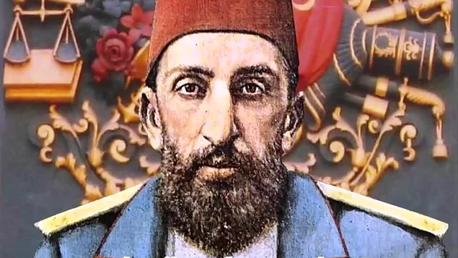
II.Abdülhamid

Slide 39
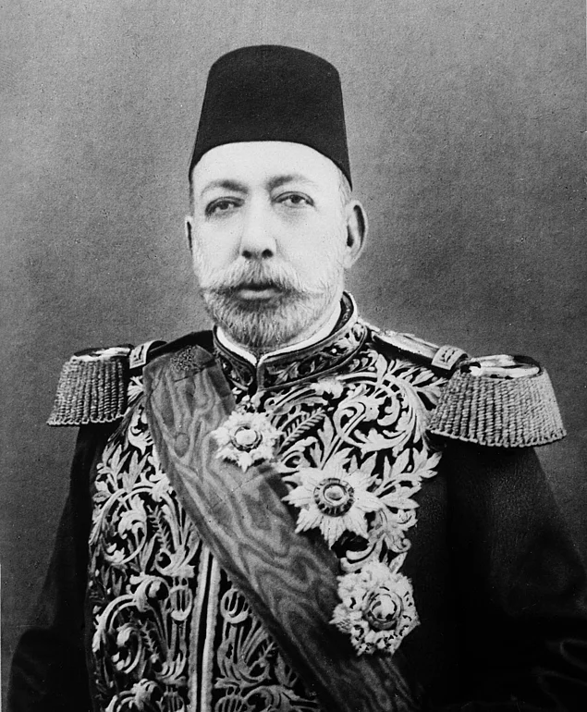
Mehmed Reşad

Slide 40
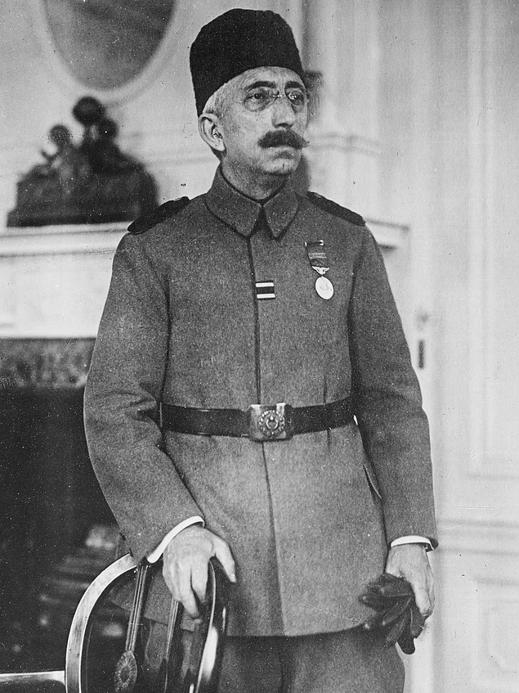
Mehmed Vahdettin

